Slide 1
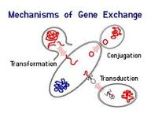
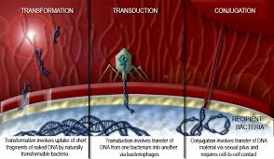
Transferencia horizontal de genes
Horizontal transfer contrasts
with vertical gene transfer in which genes move from mother
cell to daughter cell. In fact, it has been estimated that nearly
20% of the E. coli genome originated from horizontal transfers.
Horizontally transferred segments of DNA can often be detected
because they have significantly different GC ratios (the ratio of
guanine–cytosine base pairs to adenine–thymine base pairs) or
codon distributions (codon bias, Section 6.17) from those of the
host organism.

Slide 2
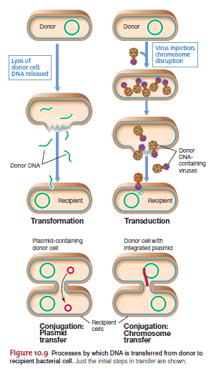

Slide 3
Assembly of new combinations of genes, increasing of diversity and speed up of evolution

Slide 4
Replica
ADN
Integra por recombinación homóloga

Slide 5
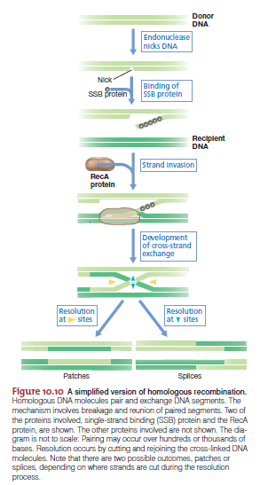
Recombinación homóloga

Slide 6
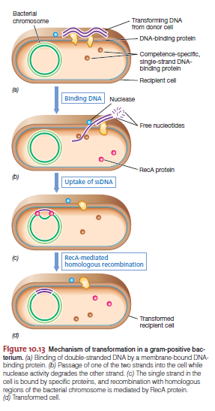
Transformación bacteriana

Slide 7
Natural
>12 genes involucrados
Regulada por quorum sensing
Uptake ssDNA
Competencia
Electrotransformación
Artificial
CaCl2
Uptake ssDNA, dDNA
Conviene hacer recD

Slide 8
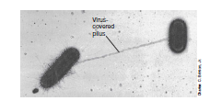
Conjugación bacteriana

Slide 9
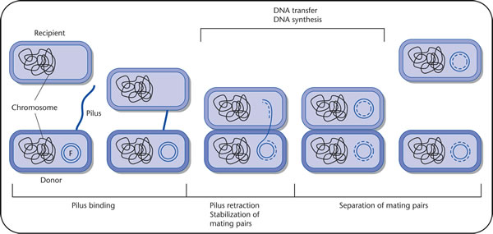
Conjugación

Slide 10
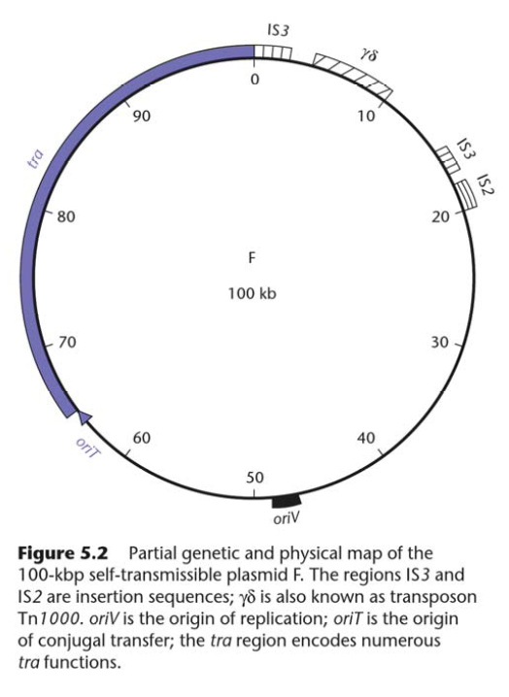
Conjugación

Slide 11
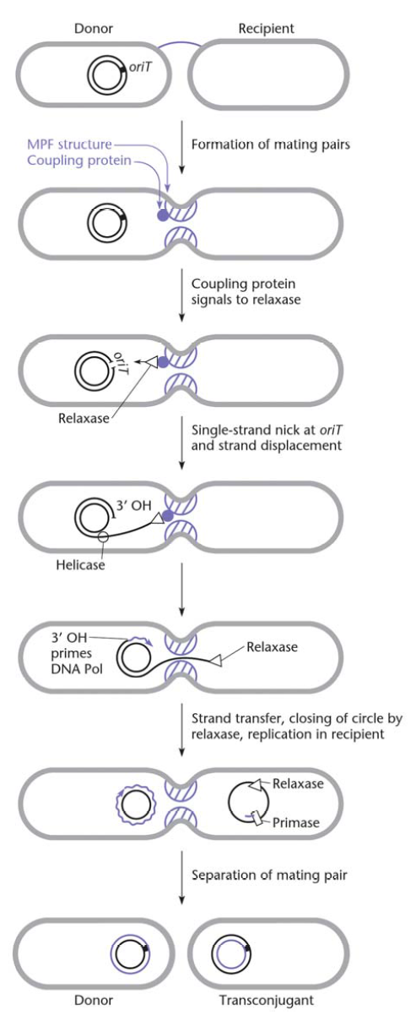
Mpf
Dtr

Slide 12
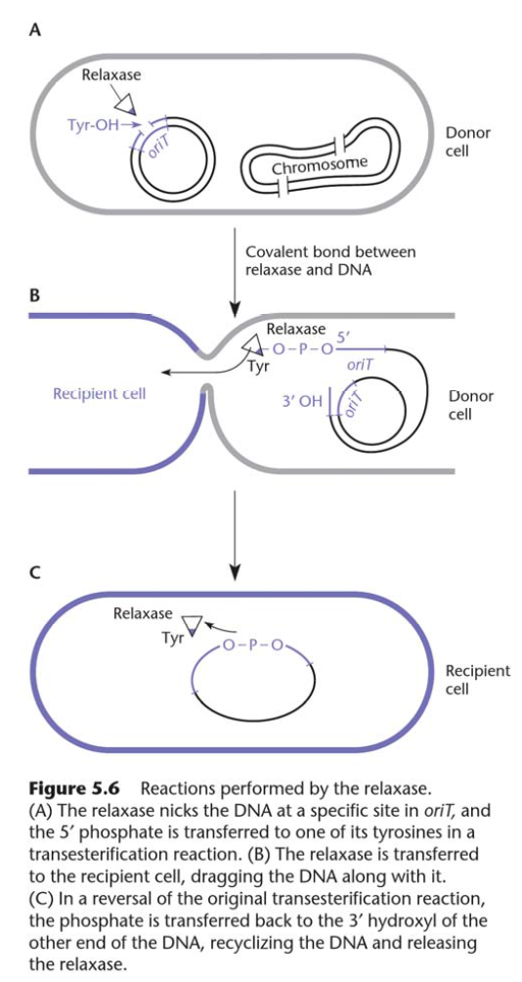

Slide 13
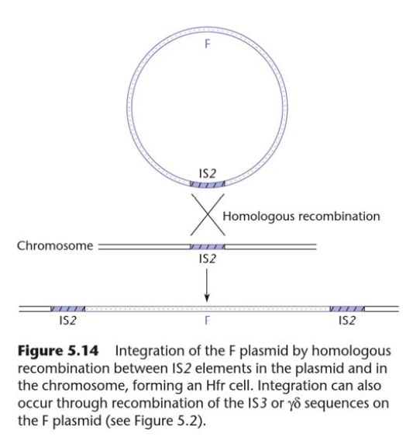
Hfr
Conjugación: Hfr
Formación

Slide 14
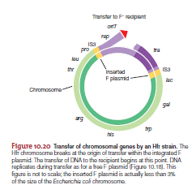
Conjugación: transferencia de genes cromosomales por Hfr

Slide 15
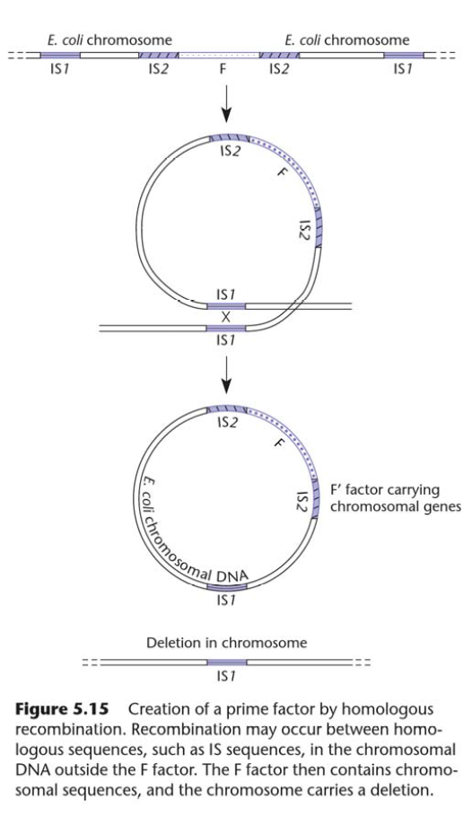
Prime factors
Conjugación: factores prima
formation

Slide 16
TP Transformación y Conjugación

Slide 17
Transformación
B. subtilis JH642 (trpC2 pheA1)
Competencia natural
In Bacillus subtilis, competence develops post-exponentially and only in certain media. In addition, only a minority of the cells in a competent culture become competent, and these are physiologically distinct.
Replicativo en E. coli
Suicida en B. subtilis
amyE-cat: CmR β-gal
Selección simples y dobles cross-over

Slide 18
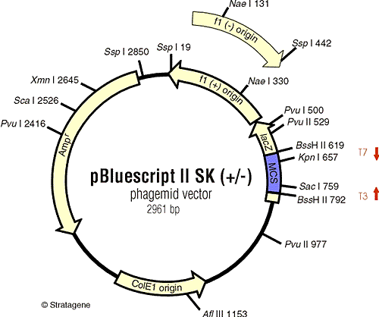
Transformación
E. coli DH5α
Competencia inducida químicamente
Replicativo en E. coli
AmpR

Slide 19
Conjugación
XLI-blue (recA1, endA1, gyrA96, thi-1, hsdR17, supE44, relA1, lac [F', proAB⁺, lacIq, lacZ Δ15::Tn10 (Tet^{R})]
MC4100 (supE44, ΔlacU169, hsdR17, gyrA96, relA1 thiΔ(lac-proAB) Sm^{R}
Exconjugantes: SmR y TetR

Slide 20
Seminarios

